Slide 1

CSC380: Principles of Data Science
Nonlinear Models
Xinchen Yu

Slide 2
Outline
Basis Functions
Support Vector Machine Classifier
Kernels
Neural Networks

Slide 3
Outline
Basis Functions
Support Vector Machine Classifier
Kernels
Neural Networks

Slide 4
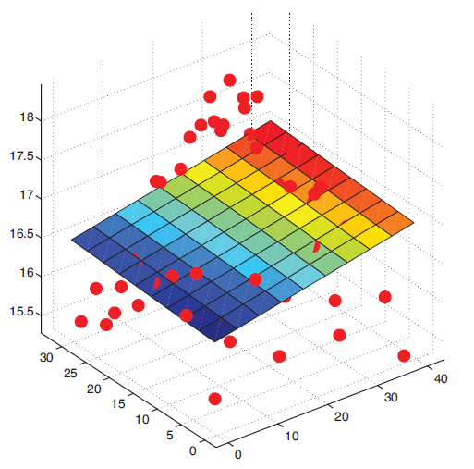
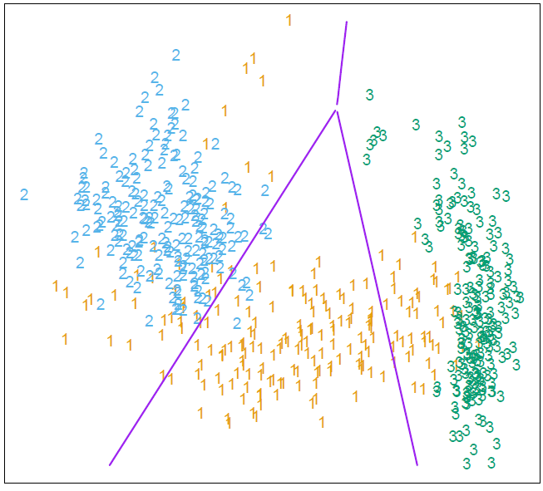
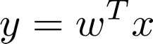
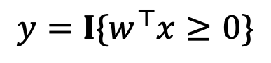
Linear Models
[ Image: Murphy, K. (2012) ]
[ Image: Hastie et al. (2001) ]
Linear Regression Fit a linear function to the data,
Logistic Regression Learn a decision boundary that is linear in the data,
$$y=I\{w^{⊤}x≥0\}$$

Slide 5
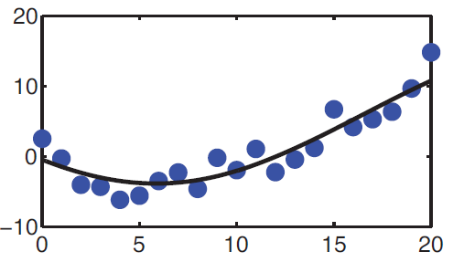
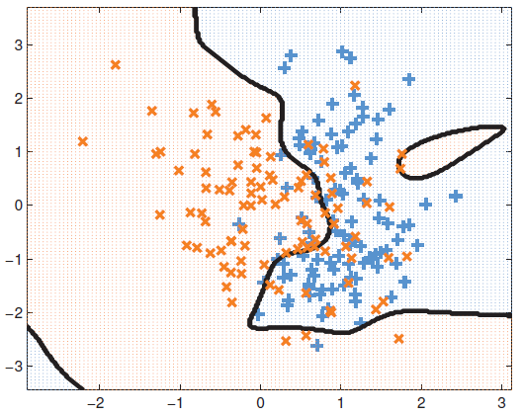
Nonlinear Data
What if our data are not well-described by a linear function?
What if classes cannot be well-distinguished by a linear function?
[Source: Murphy, K. (2012) ]

Slide 6
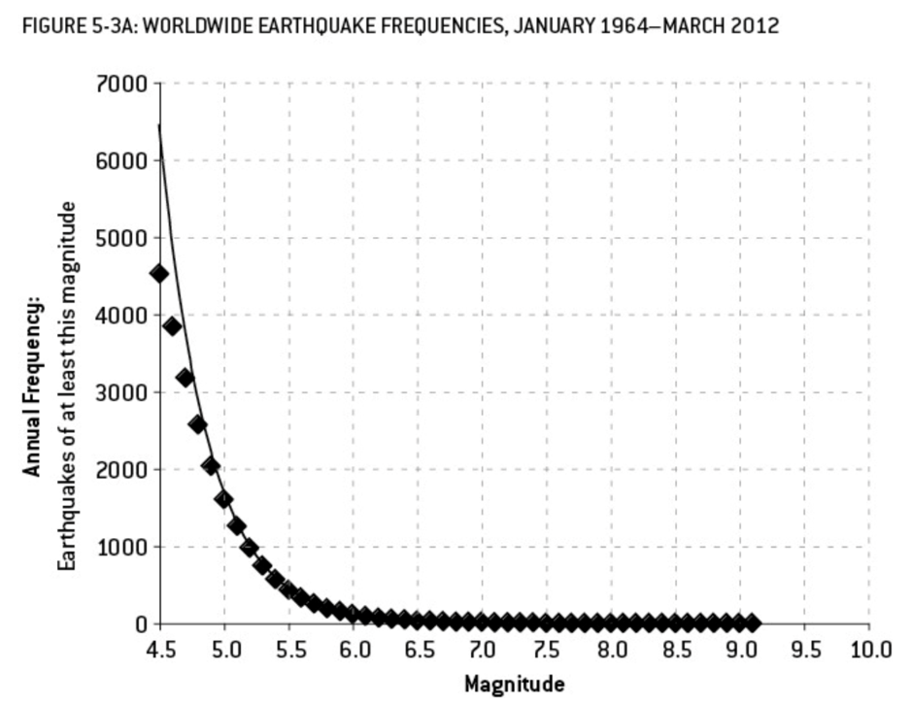
Example: Earthquake Prediction
Suppose that we want to predict the number of earthquakes that occur of a certain magnitude. Our data are given by,
Fitting a linear regression is not very helpful
[ Source: Silver, N. (2012) ]

Slide 7
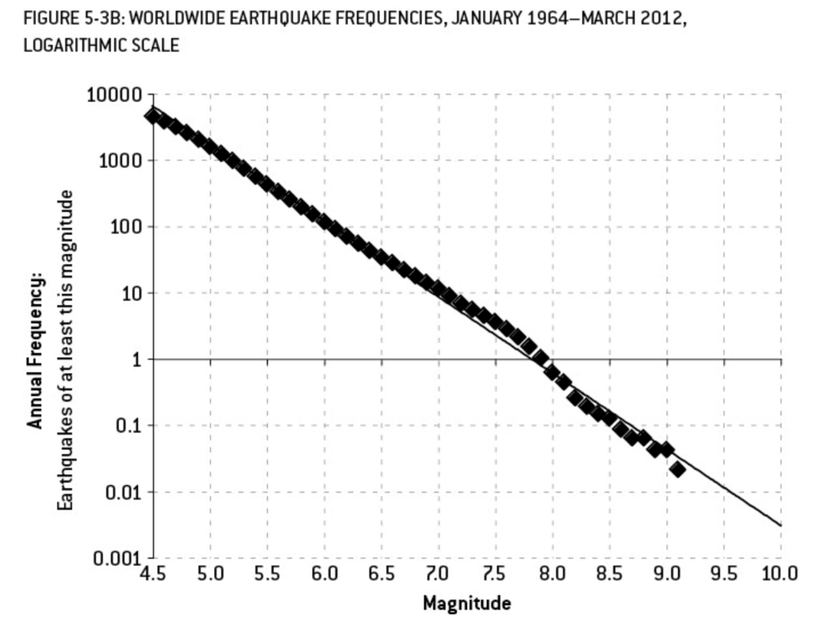
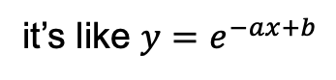
Example: Earthquake Prediction
Suppose that we want to predict the number of earthquakes that occur of a certain magnitude. Our data are given by,
(log frequency)
But plotting outputs on a logarithmic scale reveals a strong linear relationship…
it’s like $y=e^{−ax+b}$
[ Source: Silver, N. (2012) ]

Slide 8
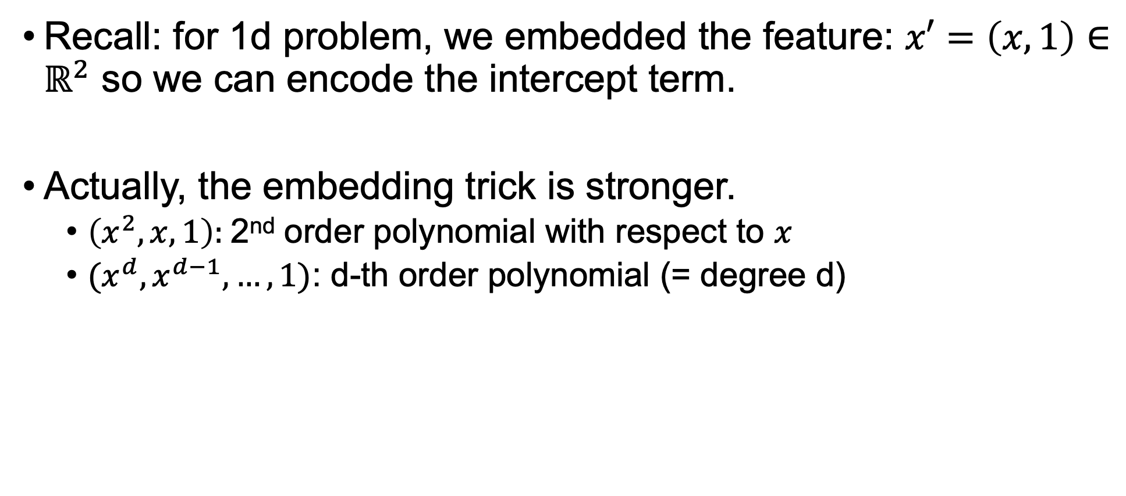
Beyond linearity: Transformation in x
Recall: for 1d problem, we embedded the feature: $x′=\left(x,1\right)∈ℝ^{2}$ so we can encode the intercept term.
Actually, the embedding trick is stronger.
$\left(x^{2},x, 1\right):$2nd order polynomial with respect to $x$
$(x^{d}, x^{d−1}, …, 1)$: d-th order polynomial (= degree d)

Slide 9
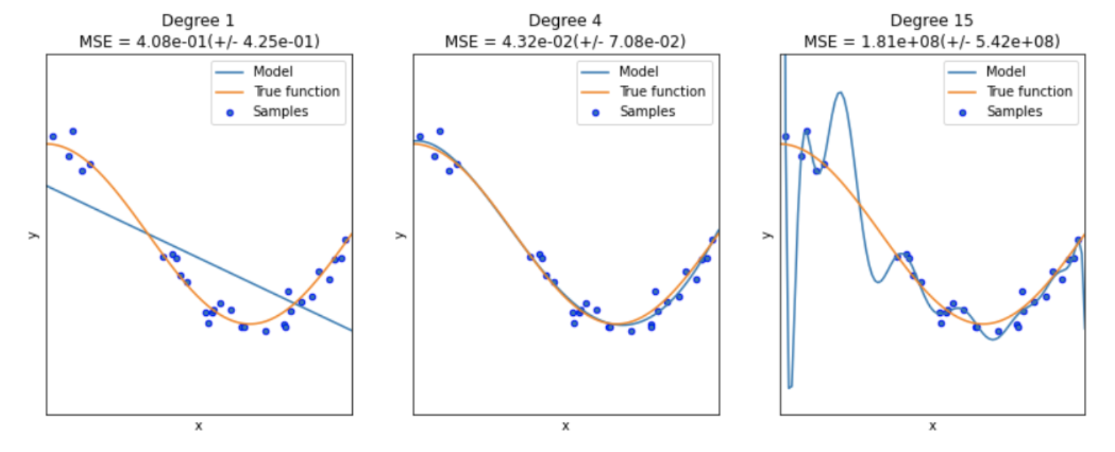
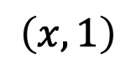
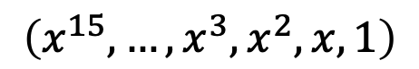
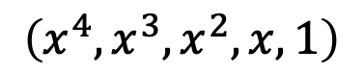
Feature embedding trick
$$\left(x, 1\right)$$
$$\left(x^{4}, x^{3},x^{2},x, 1\right)$$
$$\left(x^{15}, …,x^{3},x^{2},x, 1\right)$$
higher-order polynomial = higher complexity = prone to overfitting!
from https://datascience.foundation/sciencewhitepaper/underfitting-and-overfitting-in-machine-learning

Slide 10
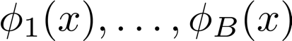
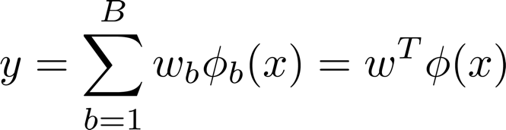
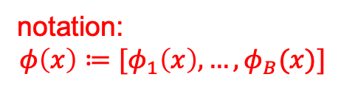
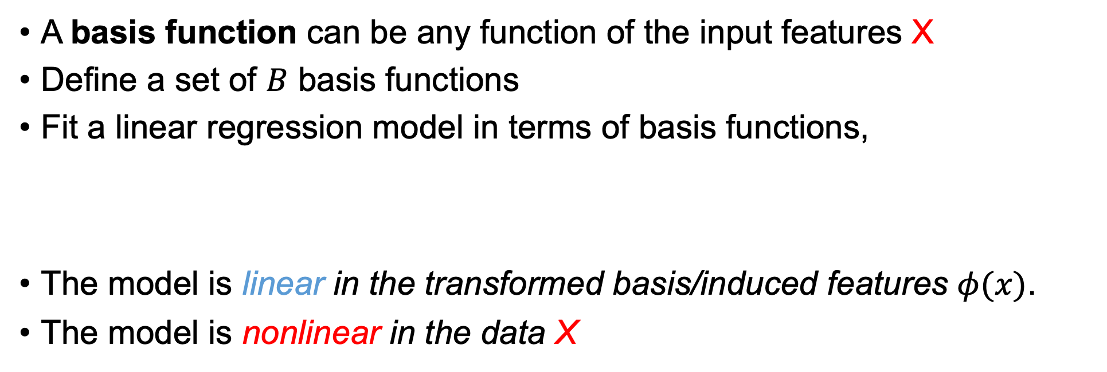
Basis Functions
A basis function can be any function of the input features X
Define a set of $B$ basis functions
Fit a linear regression model in terms of basis functions,
The model is linear in the transformed basis/induced features $φ(x)$.
The model is nonlinear in the data X
notation: $$φ\left(x\right)≔[φ_{1}\left(x\right),…,φ_{B}(x)]$$

Slide 11

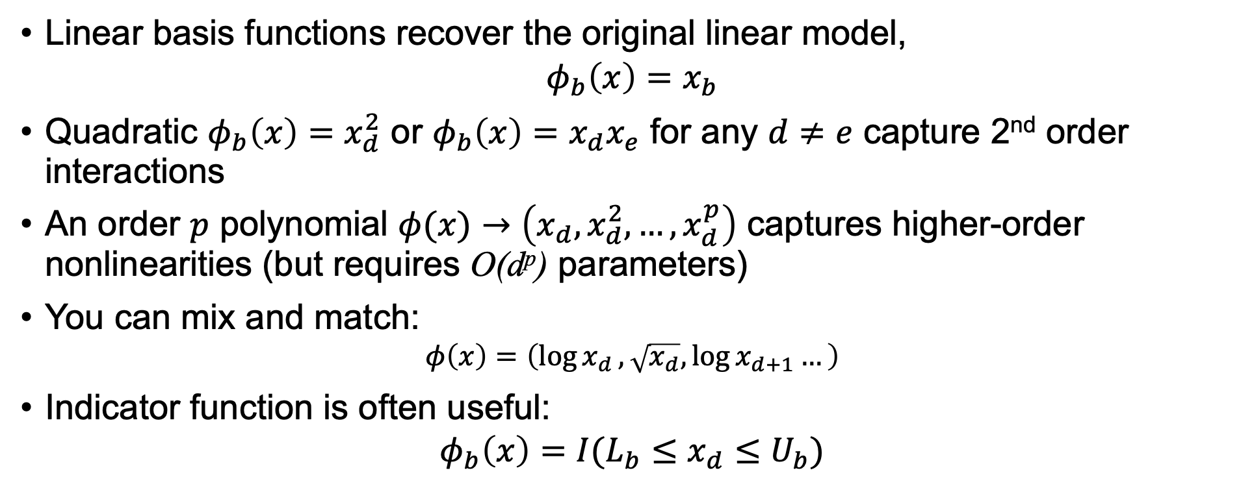
Common “All-Purpose” Basis Functions
Linear basis functions recover the original linear model,
$$φ_{b}\left(x\right)=x_{b}$$
Quadratic $φ_{b}\left(x\right)=x_{d}^{2}$ or $φ_{b}\left(x\right)=x_{d}x_{e}$ for any $d≠e$ capture 2nd order interactions
An order $p$ polynomial $φ(x)→\left(x_{d}, x_{d}^{2}, …, x_{d}^{p}\right)$ captures higher-order nonlinearities (but requires O(d^{p}) parameters)
You can mix and match:
$$φ\left(x\right)=\left(\log{x_{d}}, \sqrt{x_{d}},\log{x_{d+1}}…\right)$$
Indicator function is often useful:
$$φ_{b}\left(x\right)=I(L_{b}≤x_{d}≤U_{b})$$
Returns b^{th} dimension of X
recall $I(A)$ is 1 if $A$ is true
0 otherwise

Slide 12
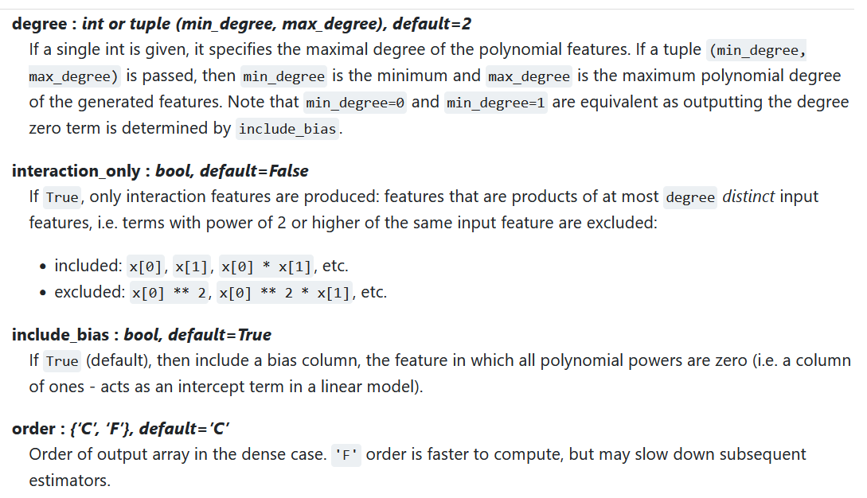

Slide 13
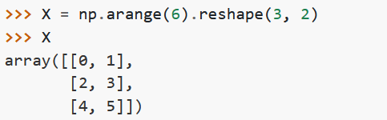
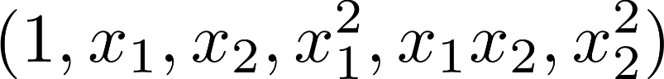
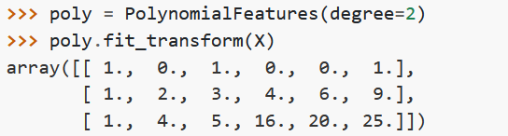
Example: Polynomial Basis Functions
Create three two-dimensional data points [0,1], [2,3], [4,5]:
Compute quadratic features ,
These are now our new data and ready to fit a model…

Slide 14
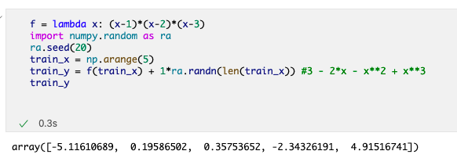
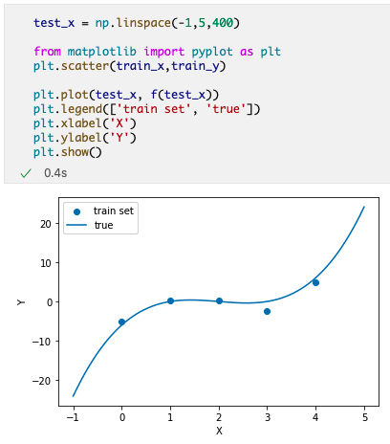
Example: Polynomial Basis Functions
Create a 3-rd order polynomial (cubic) function,
Plot train set and the actual function

Slide 15
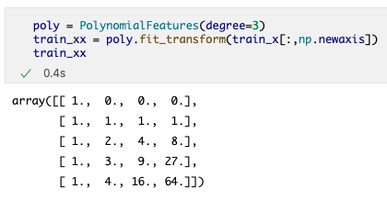
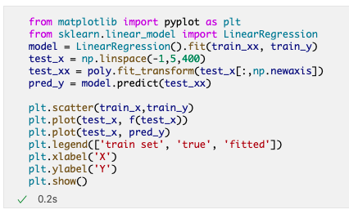
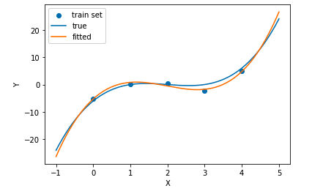
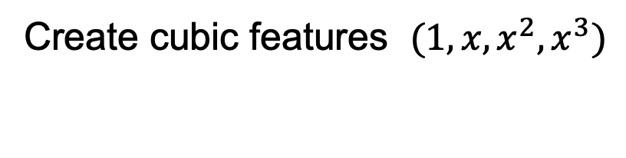
Example: Polynomial Basis Functions
Create cubic features $(1,x,x^{2},x^{3})$
turns train_x (length 5 array) into a matrix (5 by 1 matrix)
Perform linear regression; plot it

Slide 16
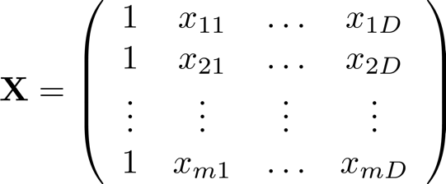
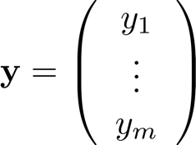
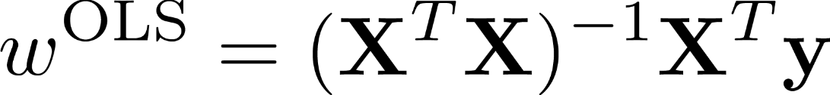
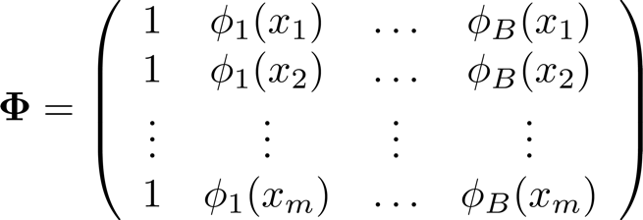
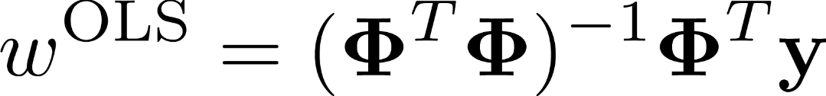
Linear Regression
Recall the ordinary least squares solution is given by,
Design Matrix ( each training input on a column )
Vector of
Training labels
Can similarly solve in terms of basis functions,

Slide 17
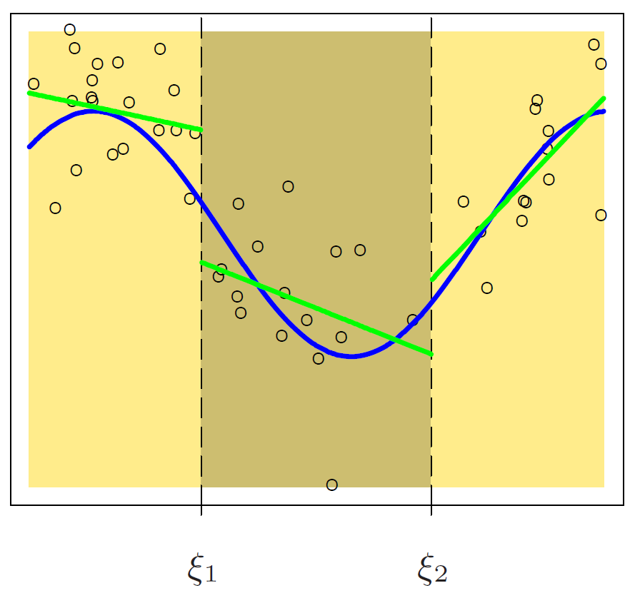
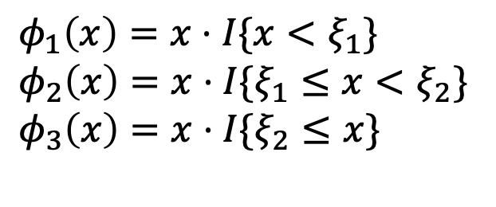
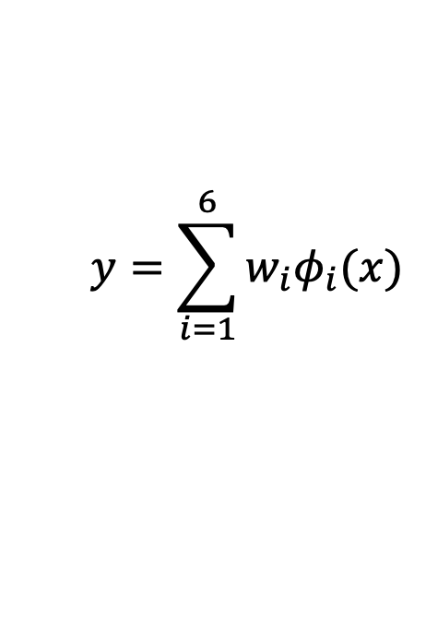
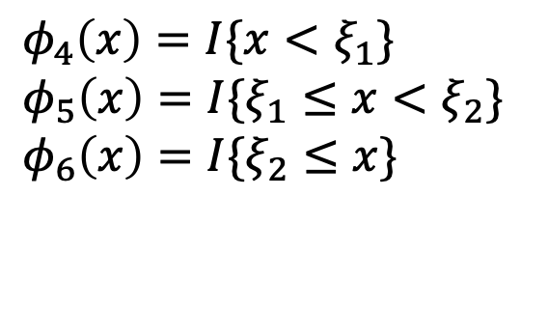
Example: Piecewise Linear Regression
[Source: Hastie et al. (2001)]
Decompose the input space into 3 regions with indicator basis functions,
$φ_{1}\left(x\right)=x⋅I\{x<ξ_{1}\}$
$φ_{2}\left(x\right)=x⋅I\{ξ_{1}≤x<ξ_{2}\}$
$φ_{3}\left(x\right)=x⋅I\{ξ_{2}≤x\}$
$φ_{4}\left(x\right)=I\{x<ξ_{1}\}$
$φ_{5}\left(x\right)=I\{ξ_{1}≤x<ξ_{2}\}$
$φ_{6}\left(x\right)=I\{ξ_{2}≤x\}$
Fit linear regression model,
$$y=\sum_{i=1}^{6}{w_{i}φ_{i}(x)}$$
Effectively fits 3 linear regressions independently to data in each region
Regression lines are discontinuous at boundary points

Slide 18
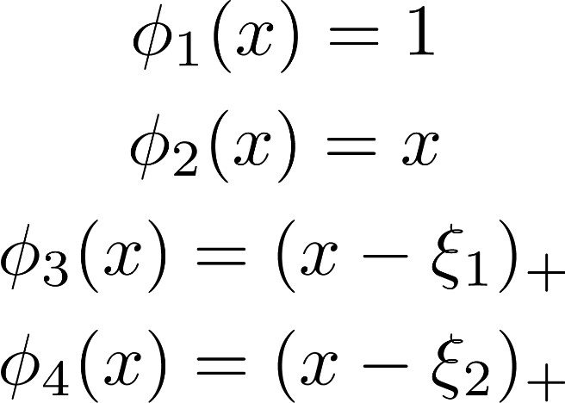
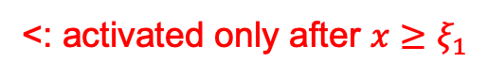

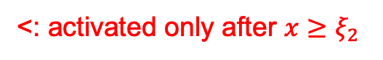
Example: Piecewise Linear Regression
[Source: Hastie et al. (2001)]
Enforce constraint that lines agree at boundary points,
<: activated only after $x≥ξ_{1}$
<: activated only after $x≥ξ_{2}$
Where ${\left(z\right)}_{+}≔\max\left\{z,0\right\}$. I.e., the positive part of $z$
An improvement, but generally prefer smoother functions…

Slide 19
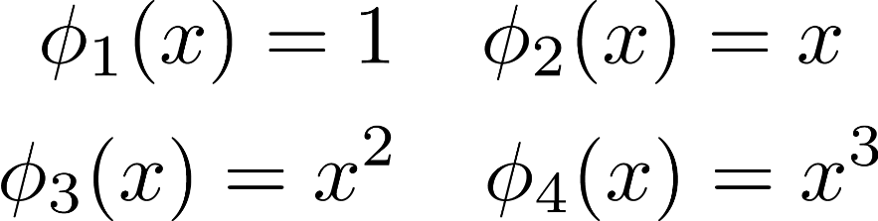
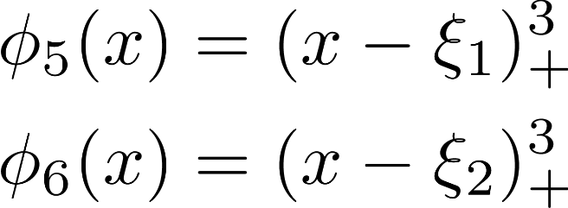
[Source: Hastie et al. (2001)]
Replace linear basis functions with polynomial,
Additional constraints ensure smooth 1st and 2nd derivatives at boundaries

Slide 20
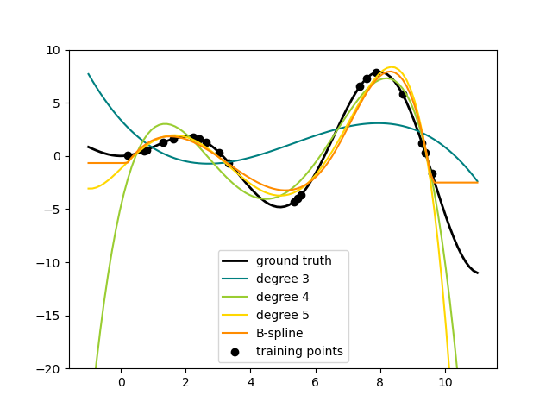
Polynomial Splines
These piecewise regression functions are called splines
Supported in Scikit-Learn preprocessing.SplineTransformer
Caution Polynomial basis functions often yield poor out-of-sample predictions with higher order producing more extreme predictions

Slide 21
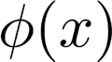
Data Preprocessing
Generally the first step in data science involves preprocessing or transforming data in some way
Filling in missing values (imputation)
Centering / normalizing / standardizing
Etc.
We then fit our models to this preprocessed data
One way to view preprocessing is simply as computing some basis function , nothing more

Slide 22
Basis Functions
PROs
More flexible modeling that is nonlinear in the original data
Increases model expressivity
CONs
Typically requires more parameters to be learned
More sensitive to overfitting training data (due to expressivity)
Requires more regularization to avoid overfitting
Need to find good basis functions (feature engineering)

Slide 23
Outline
Basis Functions
Support Vector Machine Classifier
Kernels
Neural Networks

Slide 24
Linear Decision Boundary
Forget about the ‘regression’ point of view for now..
At the end of the day, we just want a line that separates the two classes well.
[ Source: http://www-bcf.usc.edu/~gareth/ISL/ ]

Slide 25
Linear Decision Boundary
Note: Any boundary that separates classes is equivalently good on training data
Q: but if you have to choose one, which one will you choose?
[ Source: http://www-bcf.usc.edu/~gareth/ISL/ ]

Slide 26
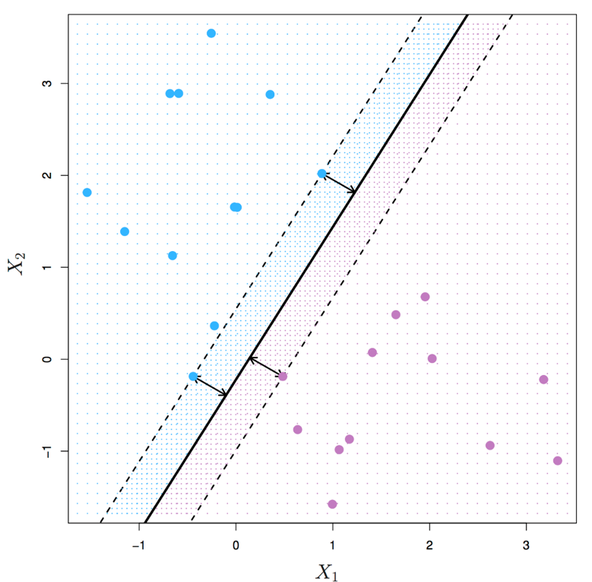
Classifier Margin
The margin measures minimum distance between each class and the decision boundary
Observation Decision boundaries with larger margins are more likely to generalize to unseen data
Idea Learn the classifier with the largest margin that still separates the data…
…we call this a max-margin classifier
[ Source: http://www-bcf.usc.edu/~gareth/ISL/ ]

Slide 27
Max-Margin Classifier (Linear Seperable Case)
For now, let’s focus on the case where the data is linearly separable
(Otherwise, there is no margin to talk about!)
[ Source: http://www-bcf.usc.edu/~gareth/ISL/ ]

Slide 28
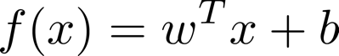
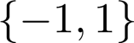
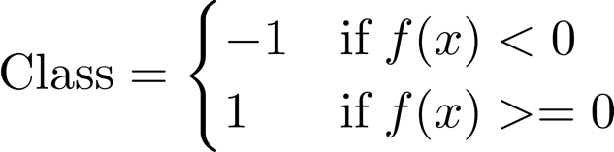
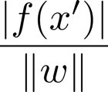








Max-Margin Classifier (Linear Separable Case)
Recall that the linear model is given by
$$f(x)>0$$
$$f(x)=0$$
$$f(x)>0$$
Let classes be so classification rule is
$$x′$$
$$\frac{|f\left(x′\right)|}{‖w‖}$$
Decision boundary is now at f(x) = 0 and distance of $x′$ to the decision boundary (margin) is
Distance from a point to a plane equation:
wiki/Distance_from_a_point_to_a_plane
where

Slide 29





Max-Margin Classifier (Linear Separable Case)
For training data ${\left\{\left(x^{\left(i\right)},y^{\left(i\right)}\right)\right\}}_{i=1}^{m}$ , a classifier $f\left(x\right)=w^{⊤}x+b$ with 0 train error will satisfy
$$y^{\left(i\right)}f\left(x^{\left(i\right)}\right)=y^{\left(i\right)}\left(w^{⊤}x^{\left(i\right)}+b\right)>0$$
↓ negative margin when misclassifying it!
$$\frac{y^{\left(i\right)}(w^{⊤}x^{\left(i\right)}+b)}{‖w‖}$$
The margin for $\left(x^{\left(i\right)}, y^{\left(i\right)}\right)$ is given by,
$$\min_{i}{\frac{y^{\left(i\right)}(w^{⊤}x^{\left(i\right)}+b)}{‖w‖}}$$
The margin of a classifier $f(x)$ is
$$\arg{\max_{w,b}{\min_{i}{\frac{y^{\left(i\right)}(w^{⊤}x^{\left(i\right)}+b)}{‖w‖}}}}$$
Find f that maximize margin

Slide 30


Max-Margin Classifier (Linear Separable Case)
Maximize the minimum margin
$$\arg{\max_{w,b}{\min_{i}{\frac{y^{\left(i\right)}(w^{⊤}x^{\left(i\right)}+b)}{‖w‖}}}}$$
Minimum margin over all training data
Find the parameters (w,b) that maximize the smallest margin over all the training data
[ Source: http://www-bcf.usc.edu/~gareth/ISL/ ]

Slide 31





Max-Margin Classifier (Linear Separable Case)
Learning objective is hard to solve in this form…
$$\arg{\max_{w,b}{\min_{i}{\frac{y^{\left(i\right)}(w^{⊤}x^{\left(i\right)}+b)}{‖w‖}}}}$$
But we can scale parameters $w→αw$ and $b→αb$ without changing the margin
But then, there exists an infinitely many solution
Optimization packages will do a bad job.
…we can pick the nearest point $j$ to the margin and restrict
$$y^{\left(j\right)}\left(w^{⊤}x^{\left(j\right)}+b\right)=1$$
$$y^{\left(i\right)}\left(w^{⊤}x^{\left(i\right)}+b\right)≥1, ∀i$$
$⇒\min_{i}{y^{\left(i\right)}\left(w^{⊤}x^{\left(i\right)}+b\right)=1}$ !!!
This means that
We now just need to choose (w,b) that minimizes $‖w‖$ under this constraint!

Slide 32


Support Vector Machine (Hard Margin)
… it leads to
This is a convex (quadratic) optimization problem that can be solved efficiently
Data are D-dimensional vectors
Margins determined by nearest data points called support vectors
We call this a support vector machine (SVM)

Slide 33


Support Vector Machine (Soft Margin)
If the data is linearly not separable,
auxiliary 'slack’ variable
C: tradeoff between margin and the slack!

Slide 34




Support Vector Machine
Equivalent formulation
$$\min_{w,b}{\frac{1}{2}{\left\|w\right\|}^{2}+C\sum_{i=1}^{m}{{\left(1 −y^{\left(i\right)}(w^{⊤}x^{\left(i\right)}+b)\right)}_{+}}}$$
$ℓ\left(f;x^{\left(i\right)},y^{\left(i\right)}\right)=$ ${\left(1−y^{\left(i\right)}f\left(x^{\left(i\right)}\right)\right)}_{+}$
$${\left(X\right)}_{+}≔\max{(X,0)}$$

Slide 35



General Principle
$$\arg{\min_{w,b}{\frac{1}{2}{\left\|w\right\|}^{2}+C\sum_{i=1}^{m}{{\left(1 −y^{\left(i\right)}(w^{⊤}x^{\left(i\right)}+b)\right)}_{+}}}}$$
$$\arg{\min_{w,b}{\frac{λ}{2}{\left\|w\right\|}^{2}+\sum_{i=1}^{m}{{\left(1 −y^{\left(i\right)}(w^{⊤}x^{\left(i\right)}+b)\right)}_{+}}}}$$
=> by setting $C=1/λ$, it’s equivalent to solve
SVM belongs to the general loss-oriented formulation!

Slide 36

Support Vectors
Those data points achieving equality $y^{\left(i\right)}\left(w^{⊤}x^{\left(i\right)}+b\right)=1−ξ_{i}$ are called support vectors.
Turns out, if you knew support vectors already, solving the optimization problem above with just the support vectors as train set leads to the same solution.
$⇒$ Leave-one-out cross validation can be done fast!

Slide 37


SVM in Scikit-Learn
SVM with linear decision boundaries,
sklearn.svm.LinearSVC
Call options include…
Only showing linear for a reason that will be clear soon…
Other options for controlling optimizer (e.g. convergence tolerance ‘tol’)

Slide 38
CSC380: Principles of Data Science
Nonlinear Models 2
Xinchen Yu

Slide 39
Outline
Basis Functions
Support Vector Machine Classifier
Kernels
Neural Networks

Slide 40





Support Vector Machine (Dual)
(Theorem) SVM can be trained in two equivalent ways.
Primal
Dual
D+1 variables
$$α∈ℝ^{m}$$
$$\min_{w,b}{{\left\|w\right\|}^{2}+C\sum_{i=1}^{m}{ξ_{i}}}$$
$$s.t. y^{\left(i\right)}\left(w^{⊤}x^{\left(i\right)}+b\right)≥1−ξ_{i}, ∀i$$
$$\max_{0≤α≤C}{ }\sum_{i}{α_{i}} −\frac{1}{2}\sum_{i}{\sum_{j}{α_{i}α_{j}y^{\left(i\right)}y^{\left(j\right)}{\left(x^{\left(i\right)}\right)}^{⊤}x^{\left(j\right)}}}$$
s.t. $\sum_{i}{α_{i}y^{\left(i\right)}=0}$
Then, the learned function is $f\left(x\right)=\sum_{i=1}^{m}{α_{i}y^{\left(i\right)}{\left(x^{\left(i\right)}\right)}^{⊤}x}$
Suppose we use the basis expansion: $x^{\left(i\right)}→φ\left(x^{\left(i\right)}\right)$
Key observation: all the operations can be done as long as we have a magic function $κ(x,x^{′})$ that evaluates $\left\langle φ\left(x\right),φ\left(x^{′}\right)\right\rangle$.
called ‘kernel’ function

Slide 41



Kernel SVM in Scikit Learn
Note: basis function is infinite dim.
(Theorem) If the kernel function $κ(x,x^{′})$ satisfies certain condition, there exists a basis function $φ\left(x\right)$ for which $κ\left(x,x^{′}\right)=⟨φ\left(x\right), φ\left(x^{′}\right)⟩$!
In fact, $φ\left(x\right)$ could even be infinite dimensional: $φ:ℝ^{d}→ℝ^{∞}$

Slide 42
Kernel SVM in Scikit Learn
General kernel-based SVM lives in:
sklearn.svm.SVC(kernel=‘kernel_name’)
Supports most major kernel types

Slide 43


Support Vector Machine (Dual)
The learned function is $f\left(x\right)=\sum_{i=1}^{m}{α_{i}y^{\left(i\right)}{\left(φ\left(x^{\left(i\right)}\right)\right)}^{⊤}φ\left(x\right)}=\sum_{i=1}^{m}{α_{i}y^{\left(i\right)}κ(x^{\left(i\right)},x) }$
Note:
We need to store training data for making prediction.
Fortunately, $α_{i}=0$ for non-support vectors.
So, we only need to store support vectors!
Q: Which ML algorithms did we have to do the same?
turns out, you can use kernels for logistic regression, but there is no such thing as support vectors in there!
=> SVM trains classifiers that require less storage!

Slide 44





for RBF,
small $γ$: complex decision boundary
large $γ$: more like linear decision boundary

Slide 45




Example: Fisher’s Iris Dataset
Classify among 3 species of Iris flowers…
Iris setosa
Iris versicolor
Iris virginica
Four features (in centimeters)
Petal length / width
Sepal length / width

Slide 46

Example: Fisher’s Iris Dataset
Fairly easy to separate setosa from others using a linear classifier
Need to use nonlinear basis / kernel representation to better separate other classes

Slide 47




Example: Fisher’s Iris Dataset
Train 8-degree polynomial kernel SVM classifier,
Generate predictions on held-out test data,
Show confusion matrix and classification accuracy,
[ Source: https://stackabuse.com/implementing-svm-and-kernel-svm-with-pythons-scikit-learn/ ]

Slide 48



Kernel Ridge Regression
Recall the solution of L2-regularized linear regression (ridge regression),
B by B
m by B
= with some algebra..
=$Φ^{⊤}{\left(ΦΦ^{⊤}+λI\right)}^{−1}y$
B by m
m by m

Slide 49





Kernel Ridge Regression
Once we learn $w$, then the prediction for $x$ is
Solution to ridge regression
$$={y^{⊤}\left(ΦΦ^{⊤}+λI\right)}^{−1}Φ⋅φ(x)$$
previous slide
m by m matrix computable by $κ(x,x^{′})$
m by 1 vector computable by
$$\left(\begin{matrix}κ(x^{\left(1\right)}, x) \\ … \\ κ(x^{\left(m\right)}, x)\end{matrix}\right)$$
Can now express regression without explicitly specifying basis functions

Slide 50




Kernel Ridge Regression
Primal
Dual
$$w=Φ^{⊤}{\left(ΦΦ^{⊤}+λI\right)}^{−1}y$$
B by B Matrix Inversion: O(B³)
m by m Matrix Inversion O(m³)
If B << m, use primal. If B >> m, use dual.
If $B=∞$, then $w$ cannot be computed anyways (why?)
But we can still make predictions with ${f\left(x\right)= y^{⊤}\left(ΦΦ^{⊤}+λI\right)}^{−1}Φ⋅φ(x)$ !!

Slide 51




Slide 52






Example: Kernel Ridge Regression
Generate some sinusoidal (periodic) data,
Define an exponentiated sinusoidal kernel,
Fit kernel ridge regression,
Plot results,

Slide 53




Trick for Multi-Class
Recall: logistic regression had a very natural extension to multi-class.
What about SVM?
[One-vs-the-rest trick]
Given: dataset $D={\left\{\left(x^{\left(i\right)},y^{\left(i\right)}\right)\right\}}_{i=1}^{m}$
For each class $c∈\left\{1,…,C\right\}$
Define label $z^{\left(i\right)}∈\{−1,1\}$ where 1 for class $c$ and -1 for other classes, for all i=1,…,m.
Train a classifier $f_{c}$ with ${\left\{\left(x^{\left(i\right)},z^{\left(i\right)}\right)\right\}}_{i=1}^{m}$
To classify $x^{∗}$, compute $\hat{y}=\arg{\max_{c∈\{1,…,C\}}{decision_value(f_{c}\left(x^{∗}\right))}}$
binary: $p(y=1 | x)$ $=\frac{1}{1+e^{−w^{⊤}x}}$
… Researchers have found a few, but it was not any better than a simple trick below.
multi-class: $p\left(y=j \right|x) =\frac{\exp\left({w^{\left(j\right)}}^{⊤}x\right)}{\sum_{c=1}^{C}{\exp\left({w^{\left(c\right)}}^{⊤}x\right)}}$
decision value: the real value $w^{⊤}x$ before we threshold it at 0

Slide 54
Outline
Basis Functions
Support Vector Machine Classifier
Kernels
Neural Networks

Slide 55




Basis Functions
Basis functions transform linear models into nonlinear ones…
Classification
( Logistic Regression )
Linear Regression
…but it is often difficult to find a good basis transformation

Slide 56


Learning Basis Functions
What if we could learn a basis function so that a simple linear model performs well…
Data Space
Warped Space
Neural Net
Ignore the circled points…I reused these from the SVM slides
…this is essentially what standard neural networks do…

Slide 57

Neural Networks
Flexible nonlinear transformations of data
Efficient learning procedure scales to massive data (compared to other nonlinear models)
Q: k-NN’s space complexity with m data points and D features
Apply to many Machine Learning / Data Science problems
Regression
Classification
Dimensionality reduction
Function approximation
Many application-specific problems
And exceptional performance on image/voice/natural language
$$O(md)$$

Slide 58




Neural Networks
Forms of NNs are used all over the place nowadays…
FB Auto Tagging
Self-Driving Cars
Creepy Robots
Machine Translation

Slide 59


Rosenblatt’s Perceptron
Despite recent attention, neural networks are fairly old
In 1957 Frank Rosenblatt constructed the first (single layer) neural network known as a “perceptron”
He demonstrated that it is capable of recognizing characters projected onto a 20x20 “pixel” array of photosensors

Slide 60






Rosenblatt’s Perceptron
Perceptron
$$σ\left(z\right)=\frac{1}{1+e^{−z}}$$
“Principles of Neurodynamics: Perceptrons and the Theory of Brain Mechanics” (1962)
Criticized by Marvin Minsky in book “Perceptrons” since can only learn linearly-separable functions
The perceptron is just logistic regression in disguise

Slide 61
Side note on the history of AI
Ongoing battle between: bottom-up vs top-down
Bottom-up: Connectionist. Mimic the biology of humans/animals.
Top-down: Symbolic/Logical approach. Mimic how humans reason.
Bottom-up is the winner nowadays; I personally believe that the reasons include computational complexity and availability of data in modern era.

Slide 62

Some battles are still going on, occasionally
Yann Lecun: famous neural network researcher
Gary Marcus: Likes symbolic systems. AI scientist, author, and entrepreneur (unclear about his standing as a researcher)

Slide 63


Multilayer Perceptron
Hidden layer perceptrons
Adding hidden layers allows NN to learn nonlinear/complex functions
input layer
output layer
perceptron
each circle is called ‘unit’
Terminologies:
width vs depth
can be seen as the basis function $φ(x)$
This is the quintessential (Artificial) Neural Network…
… the image above is a special case called Feed Forward Neural Net
feed forward: no backward connection
[ Source: http://neuralnetworksanddeeplearning.com ]

Slide 64

Neural nets history
60’s: early interest in perceptron, but the XOR problem..! (time for the symbolic camp to laugh at connectionists)
MLP was a way to get around, but people did not know how to train it
Werbos’74 breakthrough: backpropagation (but still hard to get people back) for training MLP.
NN became popular again in ‘86 with McClelland, Rumelhart, and Hinton on training large-scale neural nets.
Around ‘97 or so to ‘12 is a dark time for neural nets; probabilistic models and SVM dominated.
Circa 2012, neural nets came back as ‘deep neural networks’.

Slide 65

Modern Neural Networks
Modern Deep Neural networks add many hidden layers
each unit cube 1 by 1 by 1 is the real values it is computing given an input (e.g., image)
…and have many millions of parameters (=weights/biases) to learn
[ Source: Krizhevsky et al. (NIPS 2012) ]

Slide 66


Handwritten Digit Classification
Classifying handwritten digits is the “Hello World” of NNs
Each character is centered in a 28x28=784 pixel grayscale image
Fun fact: Kernel Ridge Regression with RBF kernel with no regularization gives 1.2% test error rate.
Modified National Institute of Standards and Technology (MNIST) database contains 60k training and 10k test images

Slide 67

Multilayer Perceptron for MNIST Classification
[ Source : 3Blue1Brown : https://www.youtube.com/watch?v=aircAruvnKk ]
Each image pixel is a number in [0,1] indicated by highlighted color
Notes:
3:37 to 8:40

Slide 68
CSC380: Principles of Data Science
Nonlinear Models 3
Xinchen Yu

Slide 69

Feedforward Procedure
Each node computes a weighted combination of nodes at the previous layer…
Then applies a nonlinear function to the result
Usually, we also introduce a constant bias parameter
(usually hidden when we visualize the network)

Slide 70





Activation functions
We call this an activation function and typically write it in vector form,
An early choice was the logistic function,
$$σ\left(z\right)=\frac{1}{1+e^{−z}}$$
Later, people found that a scaled version called tanh trains faster (=converges faster)
$$=σ\left(z\right)$$
tanh(z) = $2σ\left(2z\right)−1$
= tanh(z)

Slide 71




Nonlinear Activation functions
Another choice that is found to work even better is
the rectified linear unit (ReLU),
Or the smooth Gaussian error linear unit (GeLU),
Gaussian CDF
$$w^{⊤}x+b$$
Generic recommendation: Go with ReLU

Slide 72

Multilayer Perceptron
Final layer is a linear model…
for classification this is a logistic regression
Vector of activations from previous layer
Note: we don’t use ReLU for the last layer

Slide 73

[ Source : 3Blue1Brown : https://www.youtube.com/watch?v=aircAruvnKk ]
Each parameter has some impact on the output…need to train all these parameters simultaneously to have a good prediction accuracy

Slide 74





Training Multilayer Perceptron
For each training example, predict label and adjust weights…
How to score final layer output?
How to adjust weights?

Slide 75


Training Multilayer Perceptron
for each of exposition, 3blue1brown uses squared loss, but it should really be logistic loss here.
Score based on difference between final layer and one-hot vector of true class…
Input
[ Source : 3Blue1Brown : https://www.youtube.com/watch?v=aircAruvnKk ]

Slide 76

Training Multilayer Perceptron
Our cost function for i^{th} input is error in terms of weights / biases…
13,002 Parameters in this network
…minimize cost over all training data…
This is a super high-dimensional optimization (13,002 dimensions in this example)…how do we solve it?
Gradient descent!

Slide 77



Training Multilayer Perceptron
Need to find zero derivative (gradient) solution…
Convex Cost Function
Non-convex Cost Function
High-Dimensional Non-convex
YAY!
Boo!
Super Boo!
Actually, the situation is much worse, since the cost is super (13,002) high dimensional…

Slide 78


Training the Multilayer Perceptron
Training the MLP is challenging…but it’s much easier than how Rosenblatt did it

Slide 79






Gradient Descent
How to minimize a function?
$$\arg{\min_{w}{L(w)}}$$
Randomly start from some $w^{\left(1\right)}∈ℝ^{d}$
For $t=1,2,…$
Compute the gradient $g_{t}∈ℝ^{d}$ at the location $w^{\left(t\right)}$
Move to that direction:
$$w^{\left(t+1\right)}=w^{\left(t\right)} −η_{t}⋅g^{\left(t\right)}$$
where $η_{t}>0$ is a stepsize parameter.
If $L\left(w^{\left(t+1\right)}\right)≈L\left(w^{\left(t\right)}\right)$, stop.
The choice of $η_{t}$ matters! (default: $η_{t}=0.01$)
$$L(w)$$
$$w_{2}$$
$$w_{1}$$
https://zitaoshen.rbind.io/project/optimization/1-min-of-machine-learning-gradient-decent/

Slide 80


The Importance of Stepsize
each algorithm has a different way to set the
stepsize $η_{t}!$
SGD: $η_{t}=$some constant.
https://www.datasciencecentral.com/profiles/blogs/an-overview-of-gradient-descent-optimization-algorithms

Slide 81






Computing Gradients for Neural Nets
Consider a simpler function.
$$f\left(x,y,z\right)= \left(x+y\right)z =: qz$$
Let’s evaluate the gradient at $x=−2,y=5,z=−4$
[computation graph]
green: evaluation
red: derivative
$$\frac{∂f}{∂y}=\frac{∂f}{∂q} \frac{∂q}{∂y}=−4⋅1=−4$$
$\frac{∂f}{∂q}=z$, $\frac{∂f}{∂z}=q$, $\frac{∂q}{∂x}=1$, $\frac{∂q}{∂y}=1$
$$\frac{∂f}{∂z}=3$$
General strategy: 1. forward pass to compuate values at each node => we get the value of f(x,y,z),
2. backward pass => we get the gradient at x,y,z
figure from Stanford cs231n

Slide 82


Review: Chain rule
General strategy: 1. forward pass to evaluate values at each node => we get the value of f(x,y,z),
2. backward pass => we get the gradient at x,y,z
Every function can be written as a computation graph.
Chain rule says gradient computation can be decomposed into intermediate ones.
Essentially, ‘divide-and-conquer’ strategy.
You can implement it with recursion.
Generalize it:
define $δ\left(f_{n}\right)=1$ and compute $δ\left(f_{n−1}\right)$, and so on.
figure from Stanford cs231n

Slide 83
Autodiff
Python has an implementation of autodiff. E.g., pytorch
Q: Why don’t you want to work out gradients by yourself and hard-code it in python?
It’s just… annoying
Time-consuming
Error prone (so, risk of getting stuck for a long time!)
… but of course, hardcoded ones are faster.
before autodiff was popular, 80% of the reason why gradient descent does not converge was: mistakes in math!

Slide 84
Autodiff example
# https://pytorch.org/tutorials/beginner/blitz/autograd_tutorial.html
import torch
#- turn on the gradient tracking
x = torch.tensor([[1.0,2],[3,4]],requires_grad=True)
# requires_grad is False by default
print(x)
#-
y = x + 2
print(y) #- because we did `requires_grad`,
#-it tracks who created it.
z = y * y * 3
out = z.mean()
print(z)
print(out)
z.retain_grad()
out.backward() # execute backward pass
print("#- grads")
print(y.grad)
print(z.grad)
print(x.grad)
tensor([[1., 2.],
[3., 4.]], requires_grad=True)
tensor([[3., 4.],
[5., 6.]], grad_fn=<AddBackward0>)
tensor([[ 27., 48.],
[ 75., 108.]], grad_fn=<MulBackward0>)
tensor(64.5000, grad_fn=<MeanBackward0>)
#- grads
None
tensor([[0.2500, 0.2500],
[0.2500, 0.2500]])
tensor([[4.5000, 6.0000],
[7.5000, 9.0000]])
<ipython-input-40-a3156942a32d>:22: UserWarning: The .grad attribute of a Tensor that is not a leaf Tensor is being accessed. Its .grad attribute won't be populated during autograd.backward(). If you indeed want the gradient for a non-leaf Tensor, use .retain_grad() on the non-leaf Tensor. If you access the non-leaf Tensor by mistake, make sure you access the leaf Tensor instead. See github.com/pytorch/pytorch/pull/30531 for more informations.
print(y.grad)
np.array, with extra features
pytorch is optimized for obtaining the gradient of f w.r.t. the input only. If you want to obtain intermediate gradients, you need to use retain_grad().

Slide 85

Backpropagation
[ Source : 3Blue1Brown : https://www.youtube.com/watch?v=aircAruvnKk ]
Randomly initialize ${\left\{w^{\left(u\right)}\right\}}_{u ∈ units in neural net}$
For $i∈\{1,…, n_epochs\}$
For (x,y) in train set:
Forward pass:
evaluate the neural net output
measure the loss
Backward pass: compute the gradients.
Take the gradient step to update the weights $\left\{w^{\left(u\right)}\right\}$
Dependencies between layers.
No dependencies between units at the same layer.
Many GPU supported libraries available.

Slide 86
Example
Play with a small multilayer perceptron on a binary classification task…
https://playground.tensorflow.org/

Slide 87


Regularization
With four parameters I can fit an elephant. With five I can make him wiggle his trunk. - John von Neumann
Our example model has 13,002 parameters…that’s a lot of elephants! Regularization is critical to avoid overfitting…
…numerous regularization schemes are used in training neural networks.
but the standard is of course, $\sum_{i}{w_{i}^{2}}$

Slide 88





Slide 89


Scikit-Learn : Multilayer Perceptron
Fetch MNIST data from www.openml.org :
Train test split (60k / 10k),
Create MLP classifier instance,
Single hidden layer (50 nodes)
Use stochastic gradient descent
Maximum of 10 learning iterations
Small L2 regularization alpha=1e-4

Slide 90



Scikit-Learn : Multilayer Perceptron
Fit the MLP and print stuff…
Visualize the weights for each node…
coefs_[i]: n_input x n_output matrix of weights for layer i
…magnitude of weights indicates which input features are important in prediction

Slide 91

More Advanced Topics
Many other NN architectures exist beyond MLP
Convolutional NN (CNN) For image processing / computer viz.
Recurrent NN (RNN) For sequence data (e.g. acoustic signals, video, etc.) , long short-term memory (LSTM) is popular
Generative Adversarial Nets (GANs) For generating creepy deepfakes
Restricted Boltzmann Machine (RBM) Another generative model
Many open areas being researched
More reliable uncertainty estimates
Robustness to exploits
Interpretability
Better scalability

Slide 92

Convolutional Layer: Why is it useful?
Why is it useful?
The set of weight “patches” that encode low-level patterns (e.g., diagonal edge).
Coincides with some of the patterns researchers designed: E.g., Gabor features.
image from Stanford CS231n

Slide 93

Seeing what happens in CNN
https://youtu.be/AgkfIQ4IGaM
Notes:
face, wrikles, recognizing characters.

Slide 94
Resources
There are tons of excellent resources for learning about neural networks online…here are two quick ones:
3Blue1Brown Youtube channel has a nice four-part intro:
https://www.youtube.com/watch?v=aircAruvnKk
Free book by Michael Nielson uses MNIST example in Python:
http://neuralnetworksanddeeplearning.com/
Prof. Steven Bethard often teaches an excellent class:
ISTA 457 / INFO 557

